Slide 1

Machine Learning Project (Regression)
NAME : VAIBHAV NEWASE
BATCH : P-309

Slide 2
objective
To develop a machine learning model that predicts the life expectancy of countries based on various socio-economic, health, and environmental factors. The goal is to create a predictive model that provides accurate estimates of life expectancy, which can be used to inform public health policies, improve healthcare planning, and guide individual health decisions.

Slide 3
Dataset columns
1.Country Name : Country Names (193 unique country names) [Categorical]
2. Year : Year (2000-2015). [Categorical]
3. Status : Developed or Developing status. [Categorical]
4. Life Expectancy : Life expectancy in age. (Target Variable) [Non-categorical]
5. Adult Mortality : Probability of dying between 15 and 60 years per 1000 population . [Non-categorical]
6. Infant Deaths : Number of infant Deaths per 1000 population. [Non-categorical]
7. Alcohol : Alcohol, recorded per capita (15+) consumption (in litres of pure alcohol). [Non-categorical]
8. Percentage Expenditure : Expenditure on health as a percentage of GDP per capita(%). [Non-categorical]
9. Hepatits-B : Hepatitis B (Hep-B) immunization coverage among 1-year-olds (%). [Non-categorical]
10. Measles : Measles - number of reported cases per 1000 population. [Non-categorical]
11.BMI : Average Body mass index of entire population [Non-categorical]
12. Under Five Deaths : Number of under-five deaths per 1000 population [Non-categorical]

Slide 4
Dataset columns
13. Polio : Polio (Pol3) immunization coverage among 1-year-olds (%) [Non-categorical]
14. Total Expenditure : General government expenditure on health as a percentage of total government expenditure (%). [Non-categorical]
15. Diphtheria : Diphtheria tetanus toxoid and pertussis (DTP3) immunization coverage among 1-year-olds (%). [Non-categorical]
16. HIV/AID : Deaths per 1000 live births HIV/AIDS (0-4 years). [Non-categorical]
17. GDP : Gross Domestic Product per capita (in USD) [Non-categorical]
18. Population : Population of the country. [Non-categorical]
19. Thinness 1-19 years : Prevalence of thinness among children and adolescents for Age 10 to 19 (% )
20. Thinness 5-9 years : Prevalence of thinness among children for Age 5 to 9(%) [Non-categorical]
21. Income composition of resources : Human Development Index in terms of income composition of resources (index ranging from 0 to 1) [Non-categorical]
22. Schooling : Number of years of Schooling(years) [Non-categorical]

Slide 5
methodology
Collecting Data
Data Exploration
Data Visualization
Data Preprocessing
Implement model on dataset
Test Model
Train model
Selection of Principal Attributes
End

Slide 6
Steps taken in dataset analysis and model building
Getting data from a valid source
Importing Data
Importing necessary libraries
Fetching information about data (Data Exploration)
Dividing numerical and categorical columns
Data Cleaning (Replacing and filling null values,changing data types)
Checking for outliers
Data visualization to help understand the data
Square root transformation for columns having higher number of skewness
Used Standard Scaler for numerical columns
Used Label Encoder for categorical columns
Separating dependent and independent variables

Slide 7
Steps taken in dataset analysis and model building
Variance inflation factor to check if there is any multicollinearity between independent variables
Model Building using different regression algorithms
Checked model accuracy on polynomial regression
Evaluated the performance of model using appropriate metrics,such as R2 score,MSE,MAE
Hyperparameter tuning for Decision Tree
Normality of residues
Table showing accuracy for different algorithms used
Comparing Actual and Predicted values
Conclusion

Slide 8
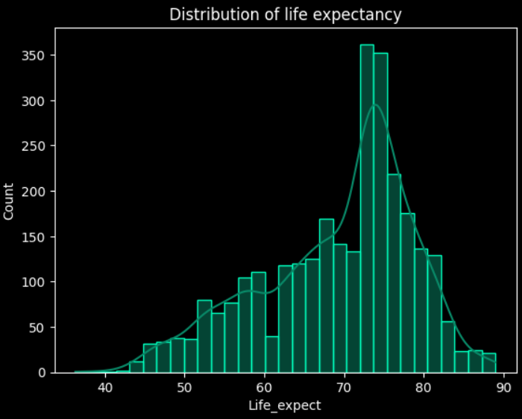
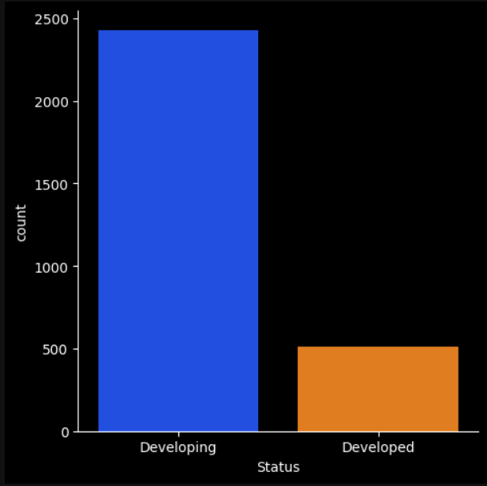
Exploratory data analysis(eda)
Distribution of Target Variable [Life Expectancy]
Count of status :

Slide 9
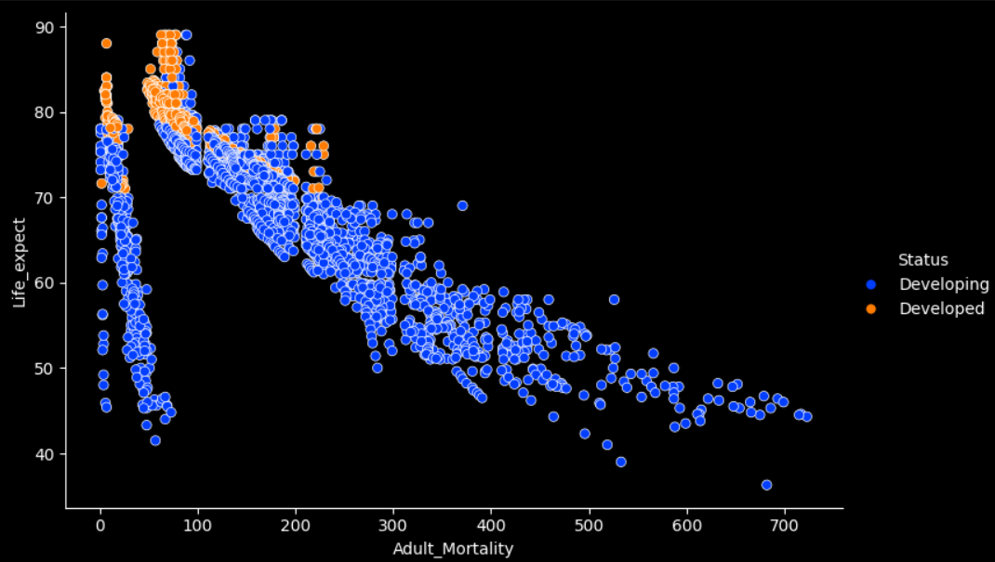
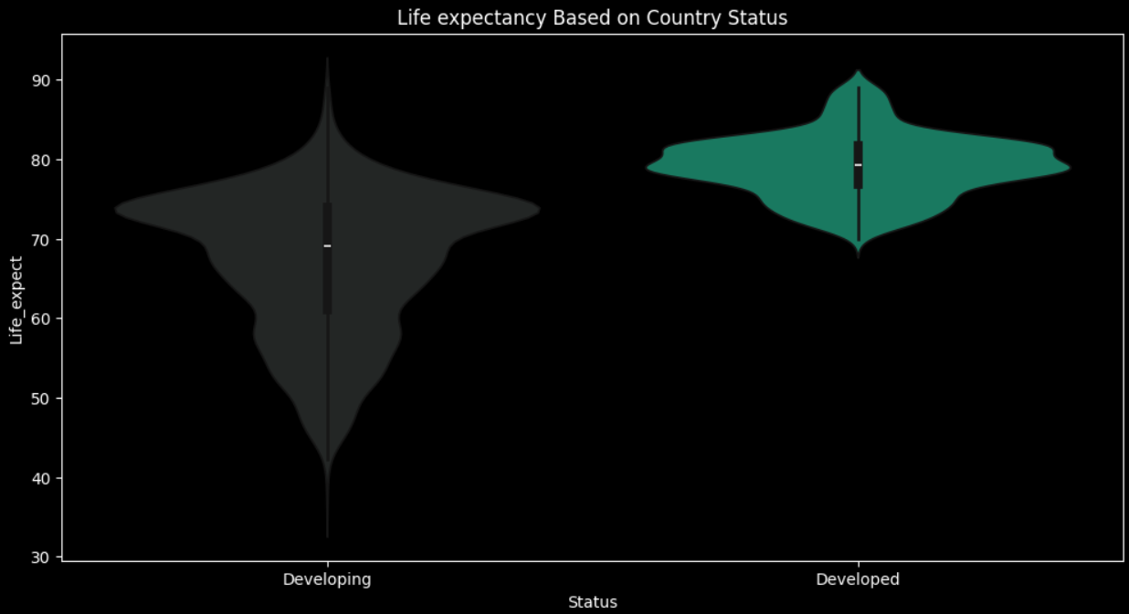
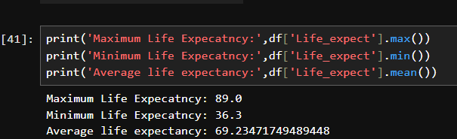
Exploratory data analysis (eda)
3. Relation between adult mortality and life expectancy 4. Life Expecatncy based on country status
5.Maximum,Minimum and Average Life expectancy

Slide 10
Graphs used for eda
Histogram : Shows the distribution of target variable
Bar plot : Count of Status for developing and developed
Pie chart : Shows distribution of status (%)
Scatter Plot : Shows relation between life expectancy and adult mortality
Violin plot : shows the summary of the life expectancy distribution based on country status
Line plot : Change in Life expectancy from 2000 to 2015
Box plot : Shows Q1,median,Q3 and maximum and also highlight outliers
Heatmap : Shows the correlation between variable

Slide 11
Algorithms used
1.Linear Regression
2. Polynomial Regression
3. Decision Tree
4. Random Forest
5. Bagging
6. AdaBoost
7. Gradient Boost
8. XGBoost
9. K-Nearest Neighbors
10. Support vector machine (SVM)
11. Hyperparameter Tuning for Decision Tree and Random forest.

Slide 12
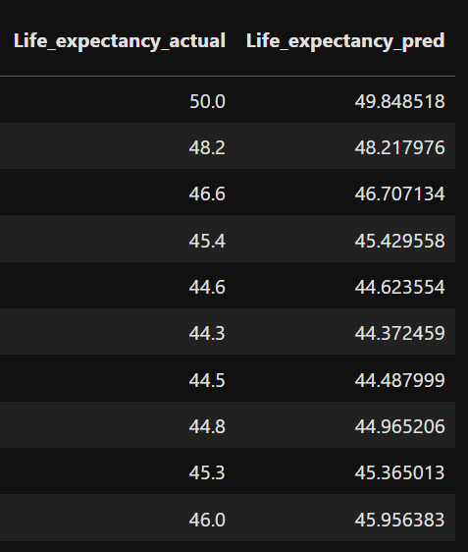
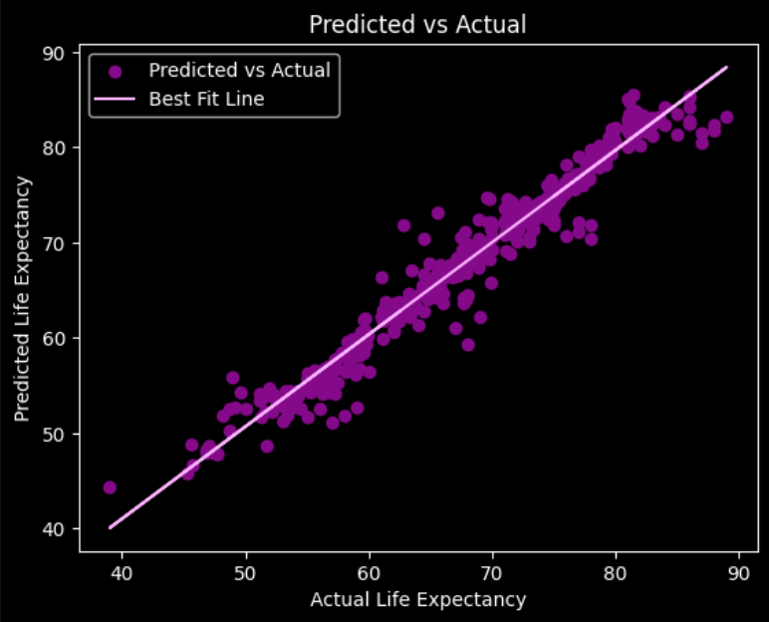
Actual VS predicted

Slide 13
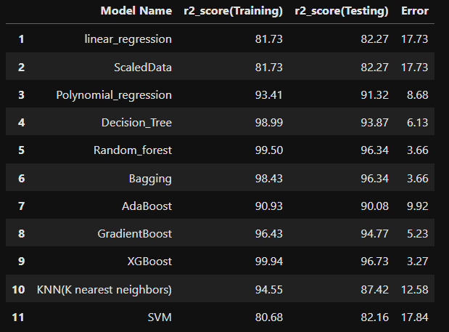
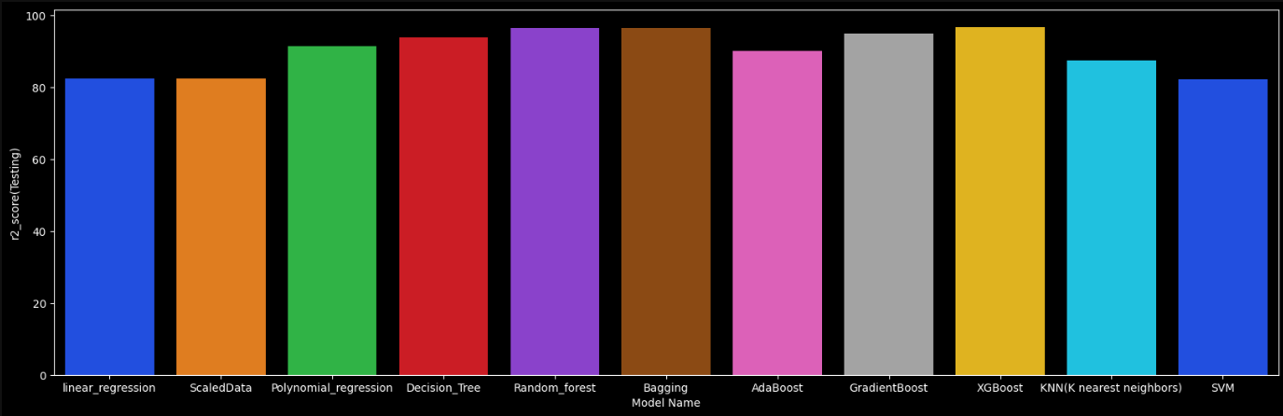
Accuracy Table

Slide 14
Conclusion
After comparing several regression algorithms, such as Linear Regression, Decision Tree Regression, Random Forest Regression, and Gradient Boosting Regression, the Random Forest Regression model and XGBoost provided the best accuracy .
The Random Forest model achieved an R² score of 0.96 and a Mean Absolute Error (MAE) of 1.1 years on the test set, indicating that our model can explain 96% of the variance in life expectancy and typically predicts life expectancy within 1.1 years of the actual value.
The most influential features identified include Adult mortality, HIV Aids ,Income composition of resources.
The findings of this project can inform policymakers about the areas needing investment and intervention. Further studies could focus on the causal relationships between these factors and life expectancy.
Our life expectancy prediction project successfully demonstrated the ability of regression models to predict life expectancy based on various factors.

Slide 15
Thank you

